Slide 1
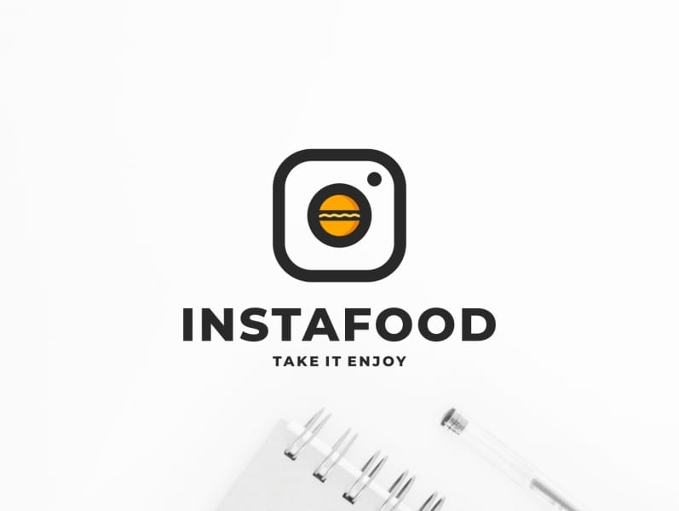
CANTEEN AUTOMATION APP
GROUP MEMBERS :-
AVDHOOT JADHAV
MOHIT SINGH

Slide 2
AIM :
CANTEEN AUTOMATION SYSTEM IS DEVELOPED WITH A PRIMARY AIM OF 'SAVING TIME. THE CUSTOMER CAN ORDER THE FOOD EASILY AND QUICKLY BECAUSE THIS SYSTEM TAKES LESSER TIME AS COMPARED TO PHONE BASED OR MANUALLY BASED SYSTEM.

Slide 3
Abstract :-
Nowadays people don’t have much time to spend in canteen by just there and waiting for the waiter to take their order. Many customer visits the canteen in their lunch break and recess so they have limited time to eat and return to their respective office and colleges. So this software helps them to save time and order food whenever they want without calling the waiter again and again.
This Canteen Automation System enables the end users to register online, read and select the food from e-menu card and order food online by just selecting the food that the user want to have using android application.

Slide 4
INTRODUCTION :-
In today’s age of fast food and take-out, many canteen have chosen to focus on quick preparation and speedy delivery of orders rather than offering a rich dining experience. What, we propose is a Canteen Automation System, which is a technique of ordering foods online applicable in any food delivery industry. The main advantage of this system is that it greatly simplifies the ordering process for both the customer and the canteen.

Slide 5
PROBLEM OBJECTIVE :-
The Challenges encountered by the manual system in canteens is efficiency and customer satisfaction. The experience of ordering in most fast food canteens is not pleasant for customers. Customers have to make long queues before placing the order and when the order is placed they have to wait near the counter until the order is prepared.
So with these application we can reduce the issue concerning the traditional way to order food in canteens.

Slide 6
DESCRIPTION:
Time Saving: Our canteen automation system is developed with a primary aim of 'Saving Time.
No Complication: Major complication part for canteen automation system is adding a product or managing products section. In our canteen automation system, no complicated part is involved in managing sections; we have taken immense care in this section and nullified all complications which make this system accurate and unique.
Security: Online systems are just as secure. Most online canteen automation system programs allow you to create multiple user accounts with various levels of access. Your data is stored on secure, protected servers that feature firewalls and other online security programs.

Slide 7
HARDWARE REQUIREMENTS:
Here's what you Need to Use the canteen automation system for online records:
AN ANDROID/IOS MOBILE PHONE.
INTERNET ACCESS.

Slide 8
SOFTWARE REQUIREMENTS:
You just need this CANTEEN AUTOMATION APP installed on your phone to use this system and you are good to go.

Slide 9
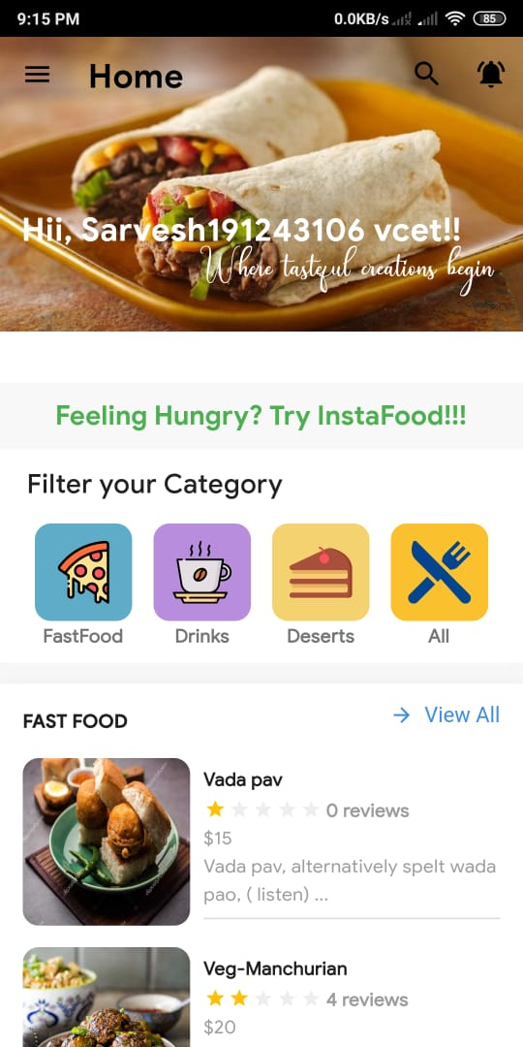
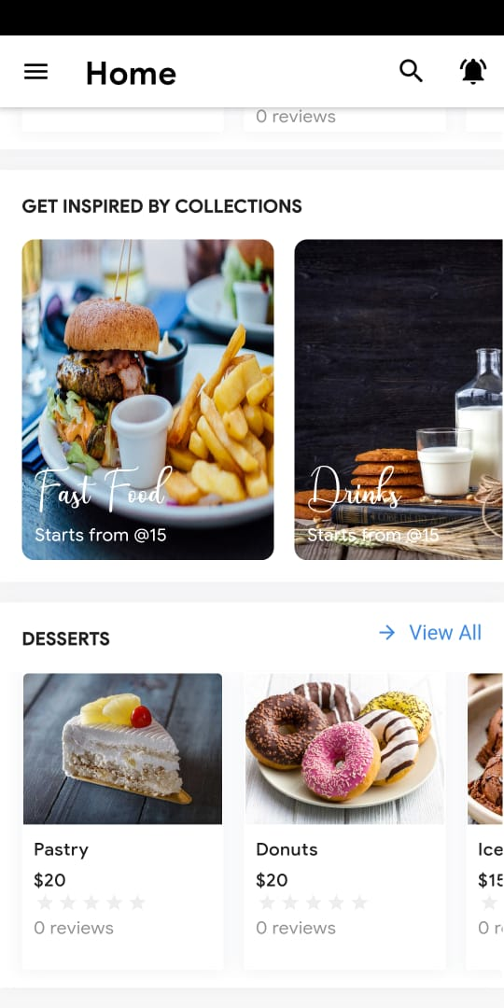
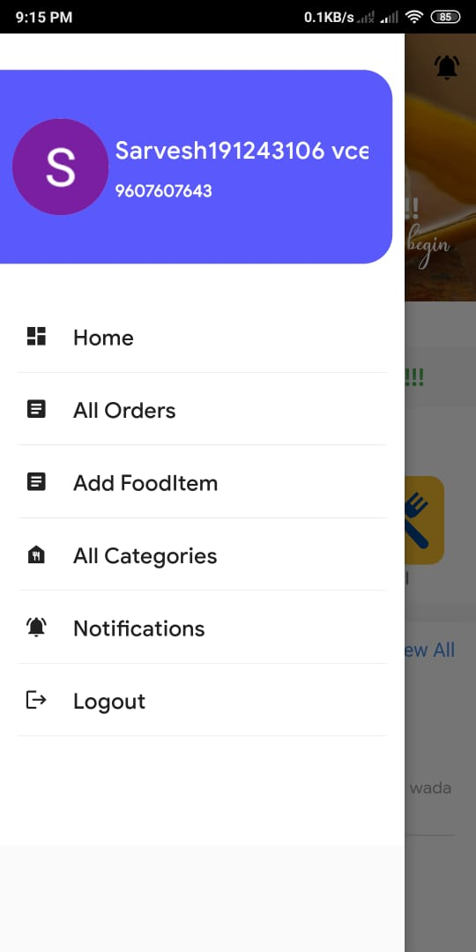
Screenshots :-

Slide 10
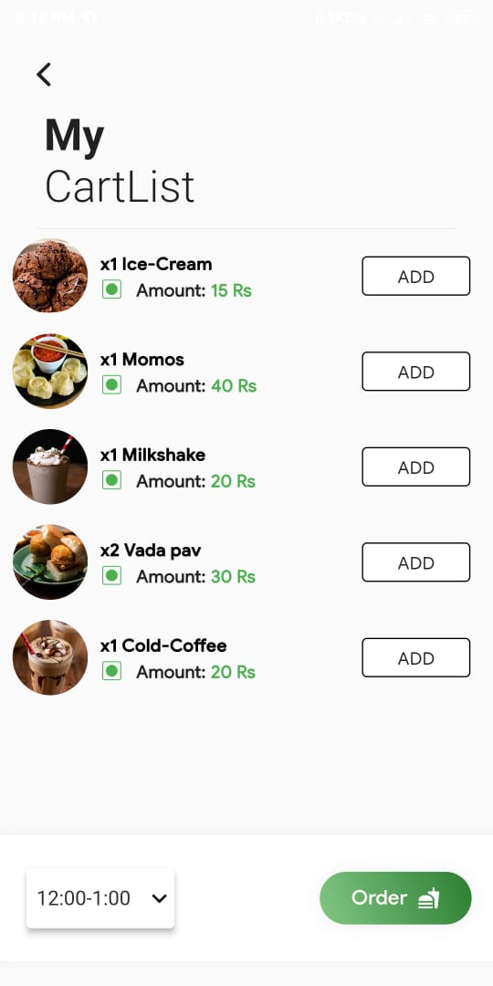
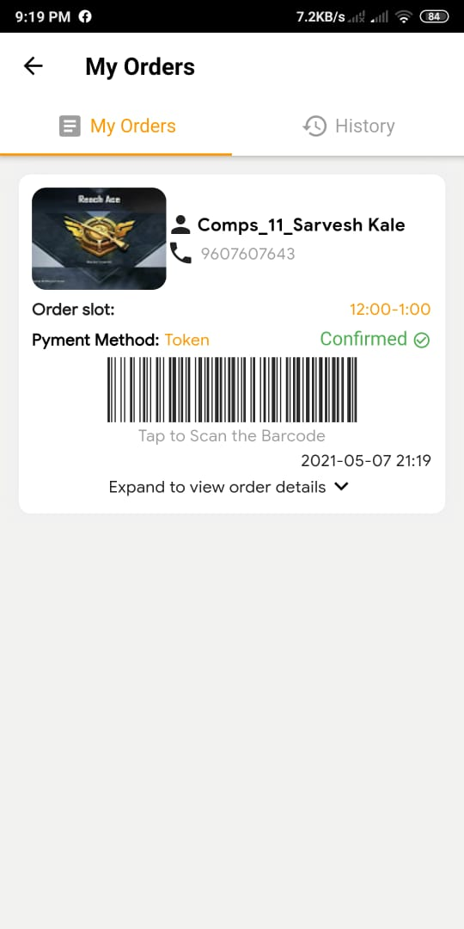
Screenshots :-

Slide 11
RESULT & CONCLUSION:
The advantage of using online system is that the scale of a canteen does not make any difference. This system can be implemented on small as well as large scale canteen business.
We can Have track of orders and we can cook the food based on customer satisfaction and we give feedback form after delivery of food in application so the Chef can cook according to customer satisfactions.

Slide 12
REFERENCES
For exploring packages used in application: https://pub.dev/
Useful Links:
Flutter download: https://flutter.dev/docs/development/tools/sdk/releases
Flutter installation: https://www.youtube.com/watch?v=L2qV2QOVklk
Flutter Tutorials: https://youtube.com/playlist?list=PL4cUxeGkcC9jLYyp2Aoh6hcWuxFDX6PBJ

